Slide 1
MISSIONARY TEACHERS
Serving the Lord in Public and Private schools in Colombia
- 2013 -
Source: www.philipnunn.com
Teamwork > Support Mission

Slide 2
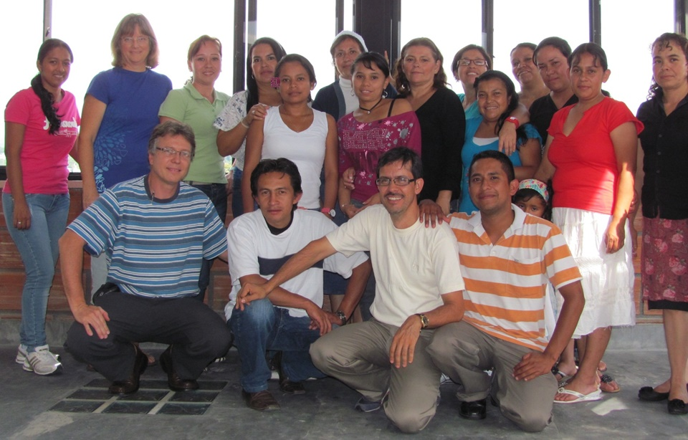
WHO are They?
Team meeting for sharing, encouraging and training
2 x year

Slide 3
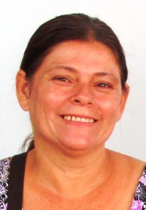
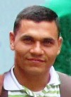
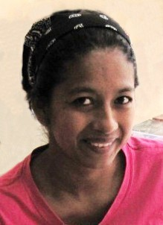
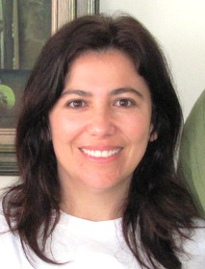
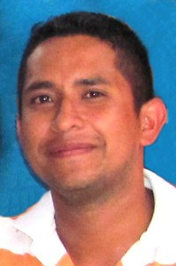
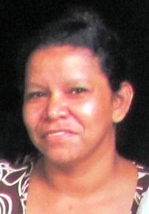
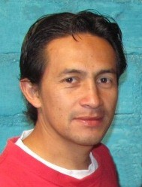
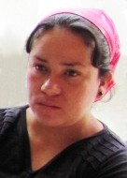
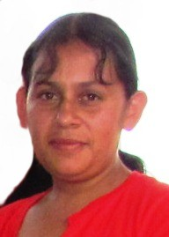
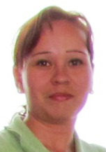
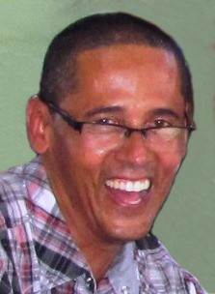
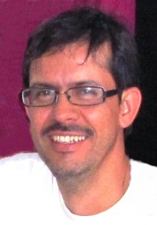
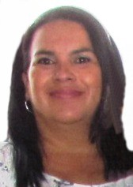
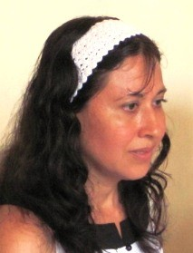
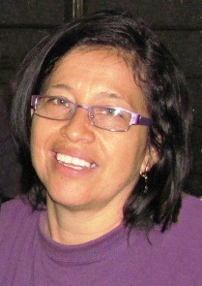
WHO are They?
Maria Elena
Zulma
Eduar
Daissy
Jorge
Nerié
Milena
Olga
Yenny
Juan Pablo
Lida
Stella
Martha
Rubiel
Fernando

Slide 4
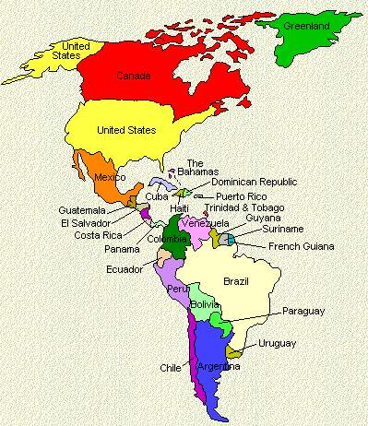
WHERE do they live?

Slide 5
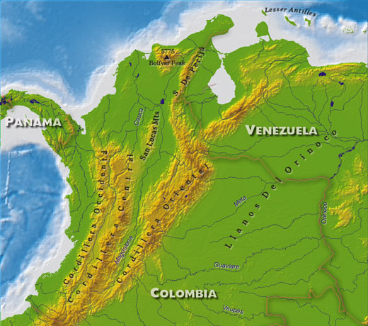
In towns and villages over much of the country!
WHERE do they live?
X
X
X
X
X
X
X
X
X

Slide 6
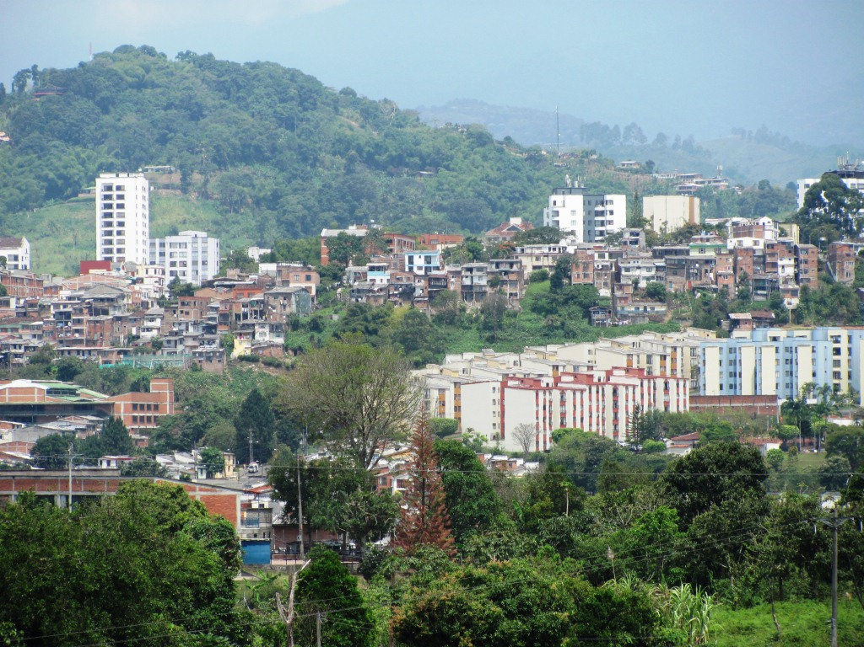
WHERE do they live?

Slide 7
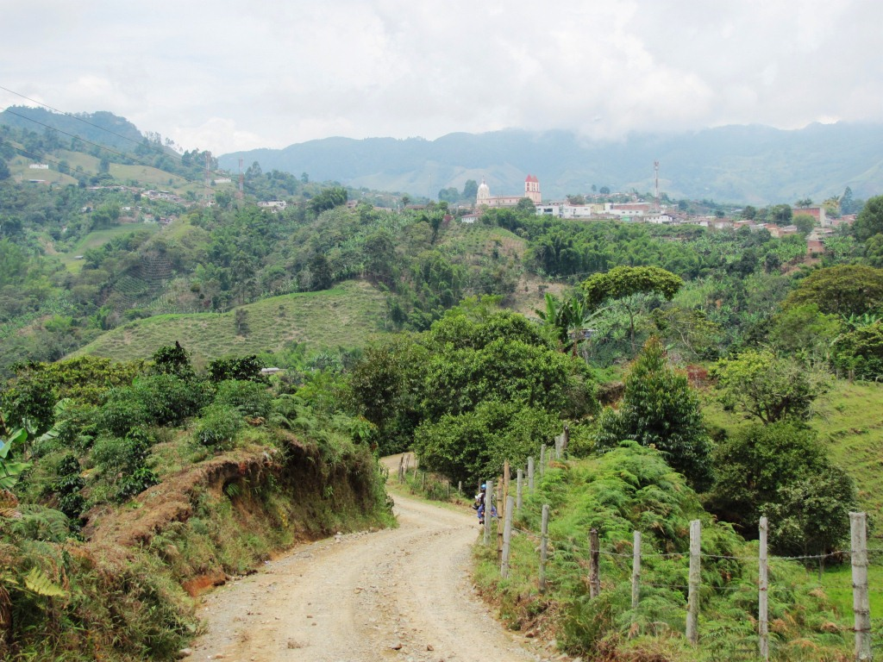
WHERE do they live?

Slide 8
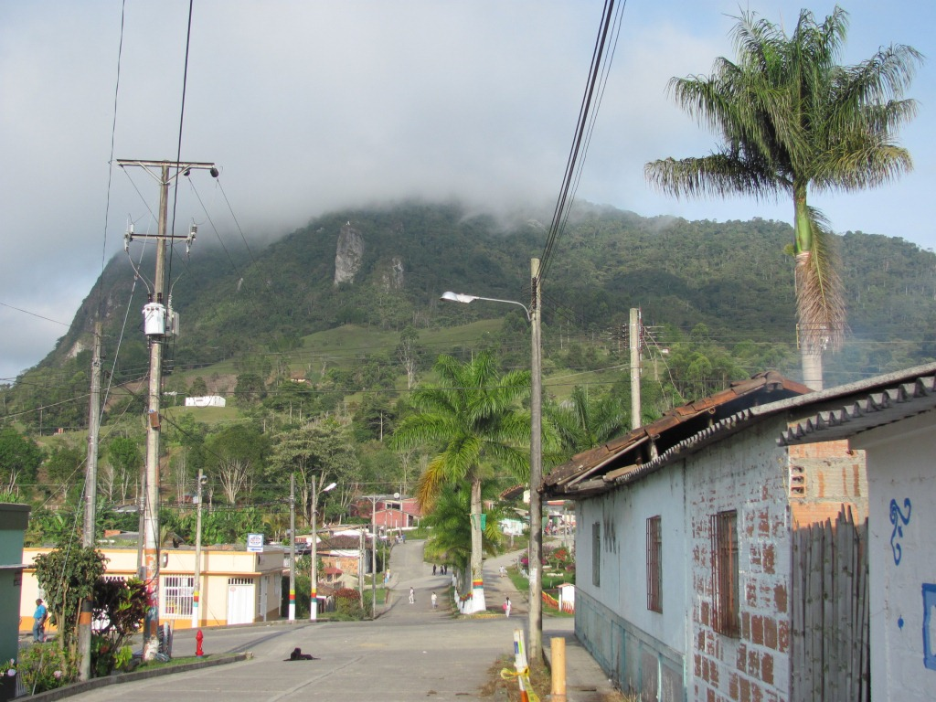
WHERE do they live?

Slide 9
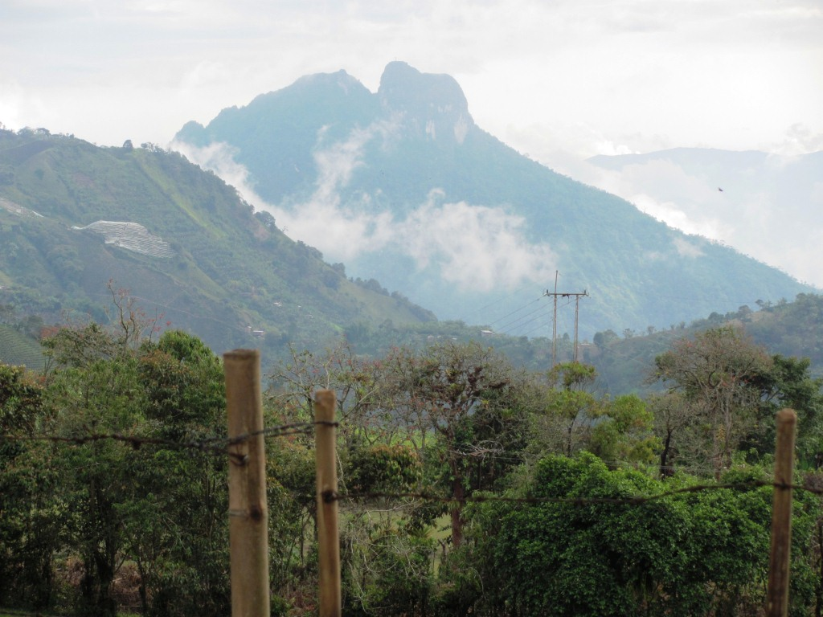
WHERE do they live?

Slide 10
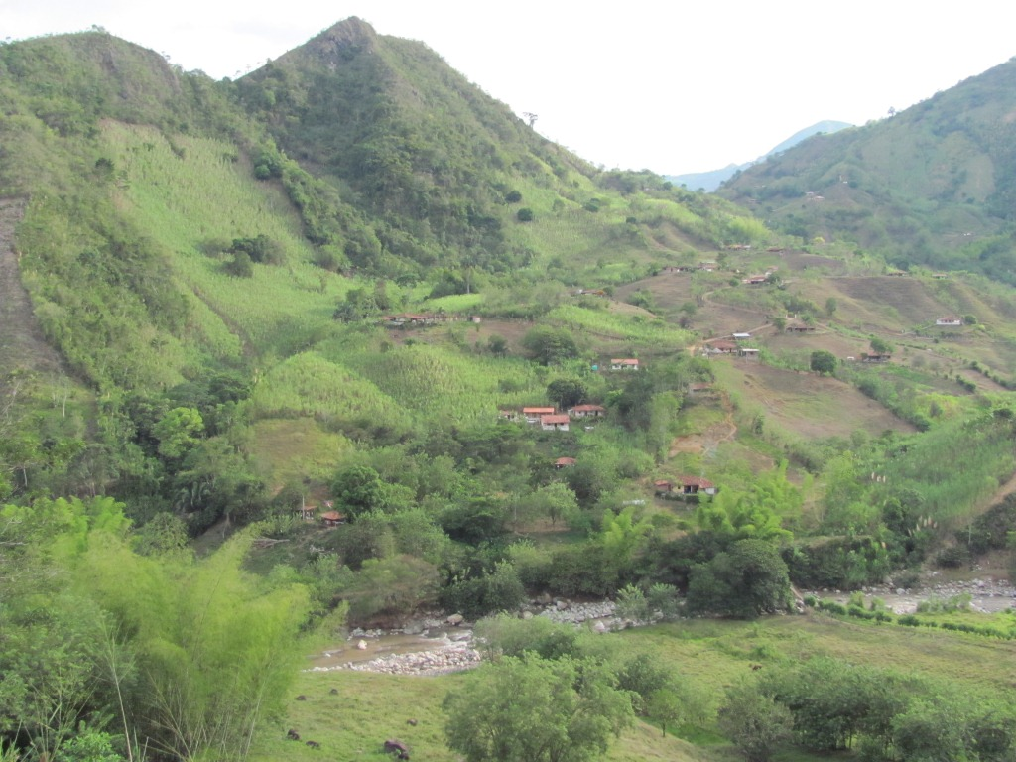
WHERE do they live?

Slide 11
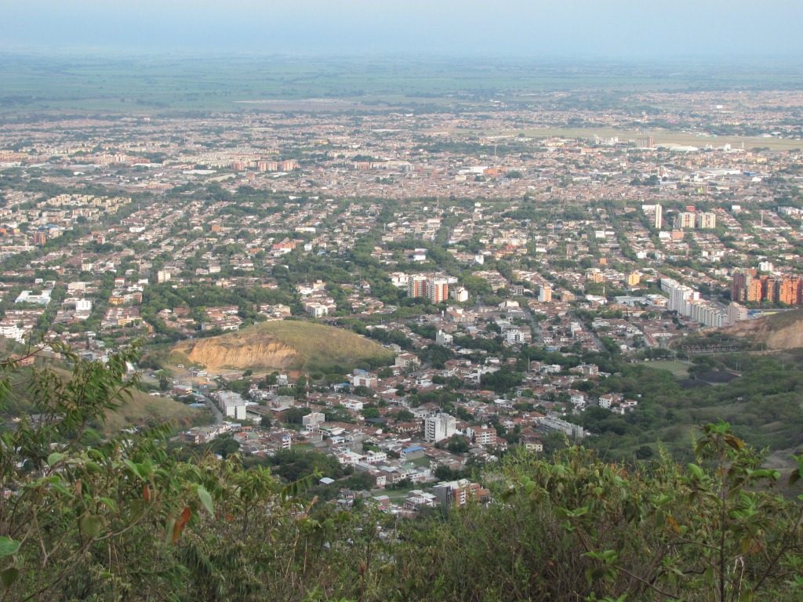
WHERE do they live?

Slide 12
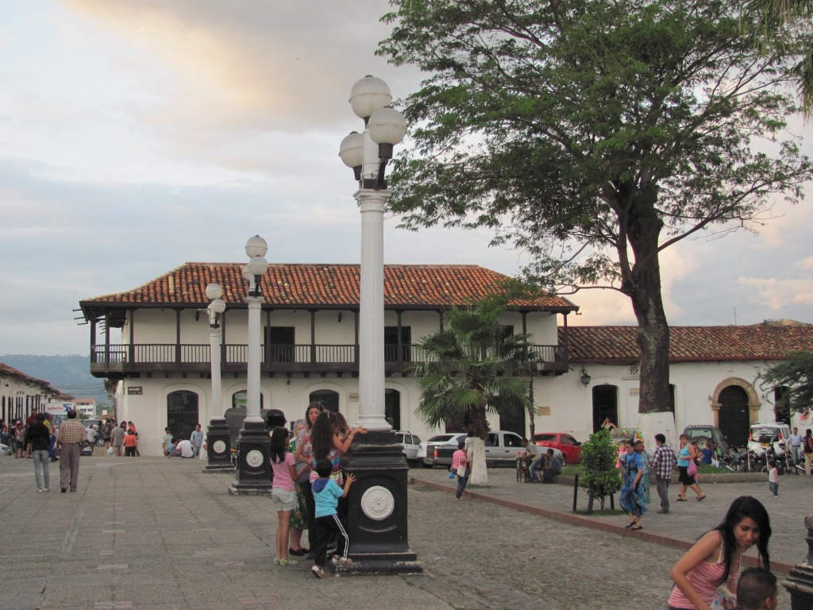
WHERE do they live?

Slide 13
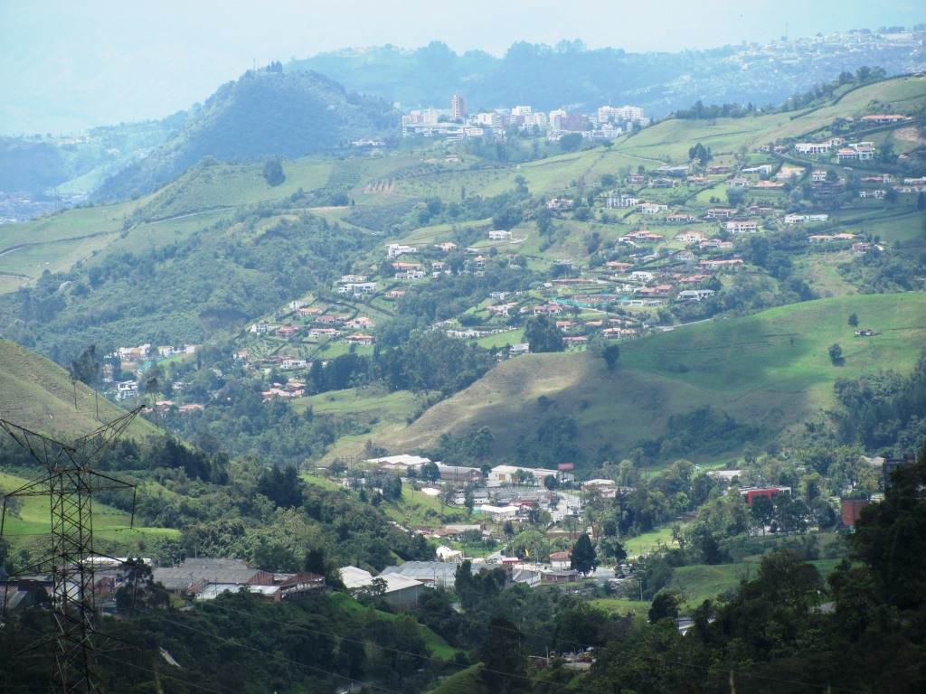
WHERE do they live?

Slide 14
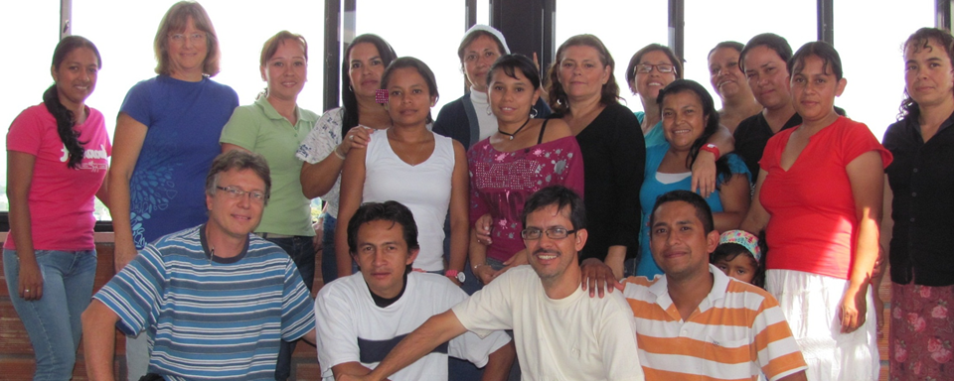
What a great work! ☺
HOW do they do it?
This group of special people are Christian Teachers, sharing the Gospel of Jesus and Bible stories with boys and girls and young people in 36 different schools in Colombia.

Slide 15
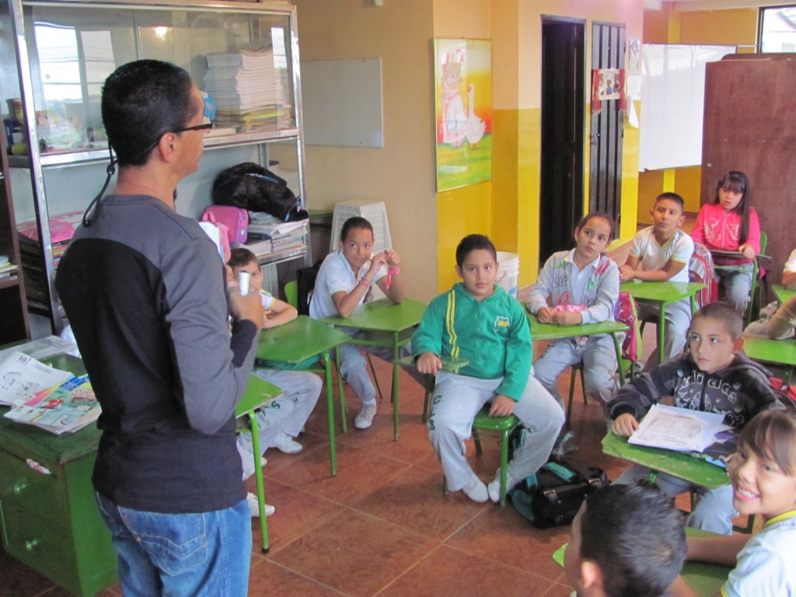
To WHOM do they go?

Slide 16
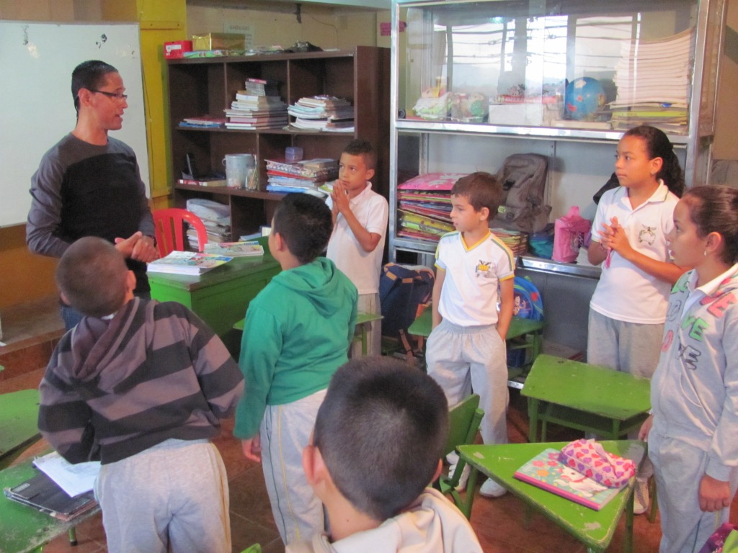
To WHOM do they go?

Slide 17
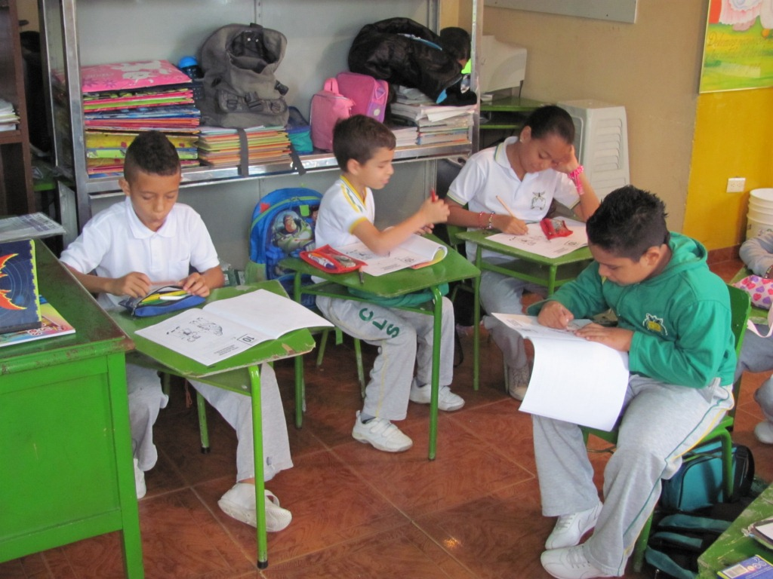
To WHOM do they go?

Slide 18
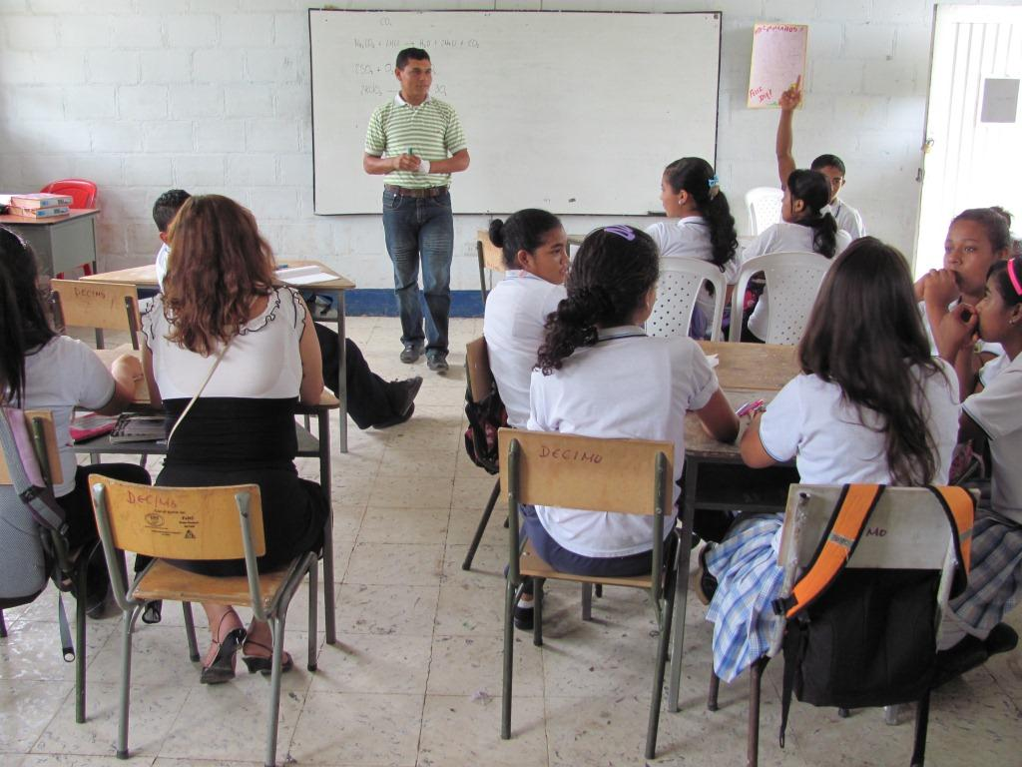
To WHOM do they go?

Slide 19
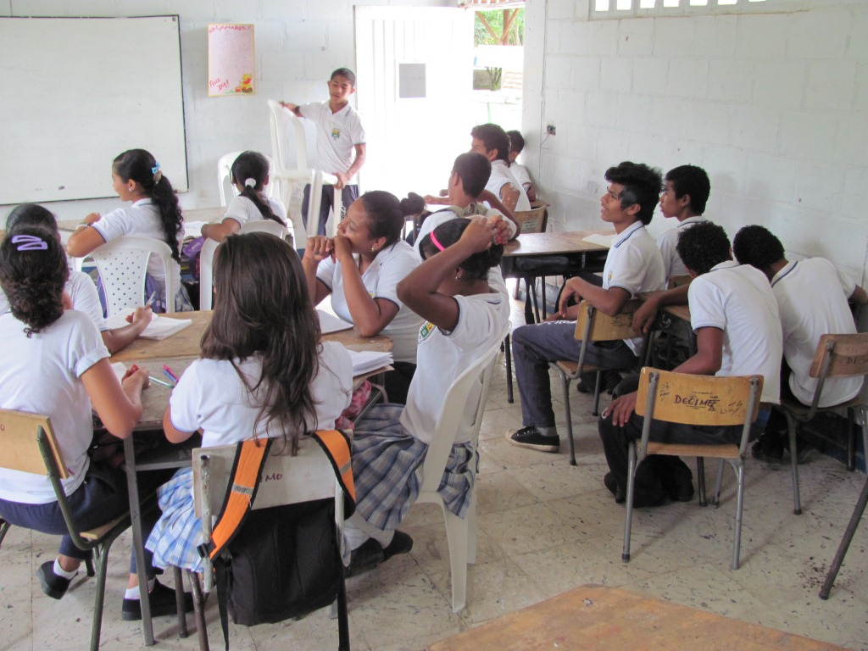
To WHOM do they go?

Slide 20
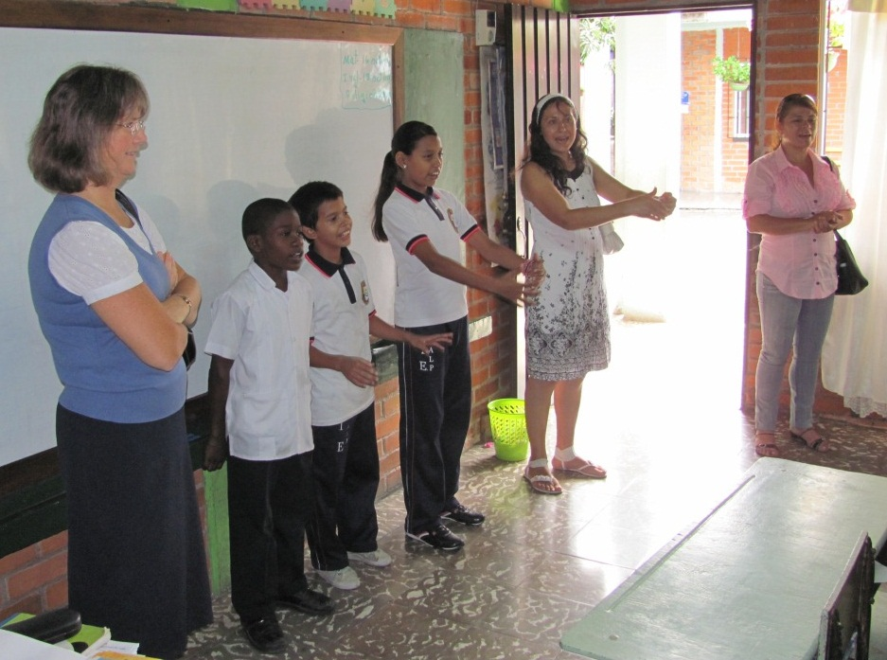
To WHOM do they go?

Slide 21
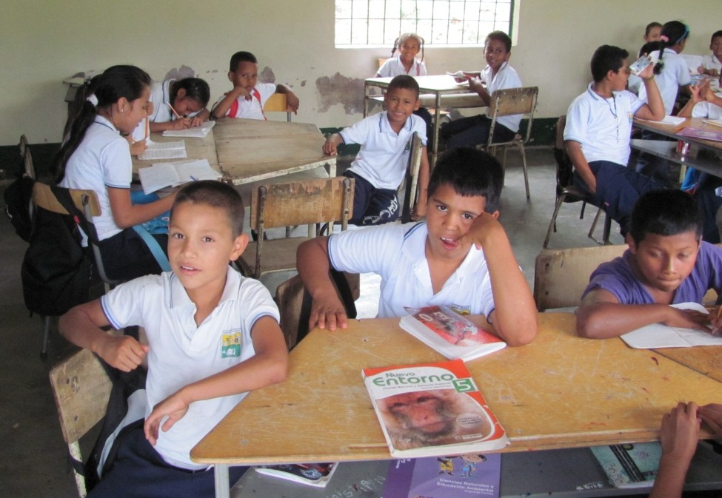
To WHOM do they go?

Slide 22
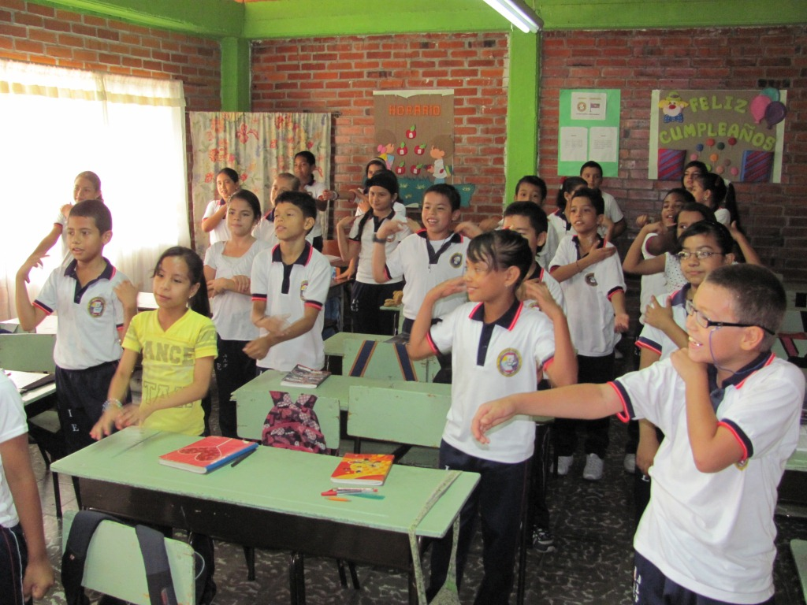
To WHOM do they go?

Slide 23
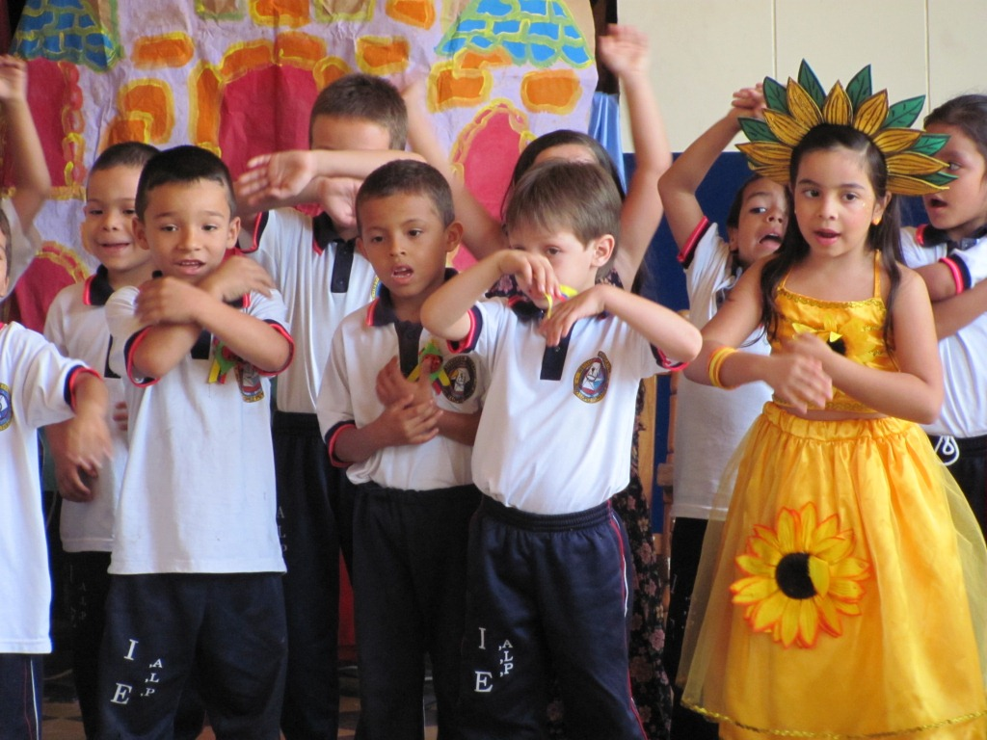
To WHOM do they go?

Slide 24
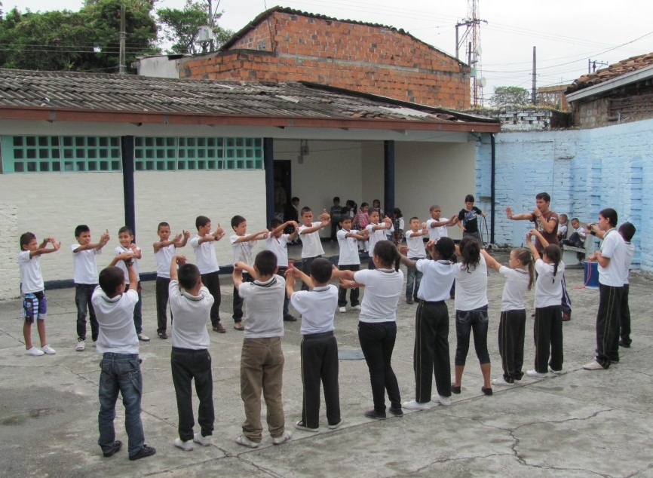
To WHOM do they go?

Slide 25
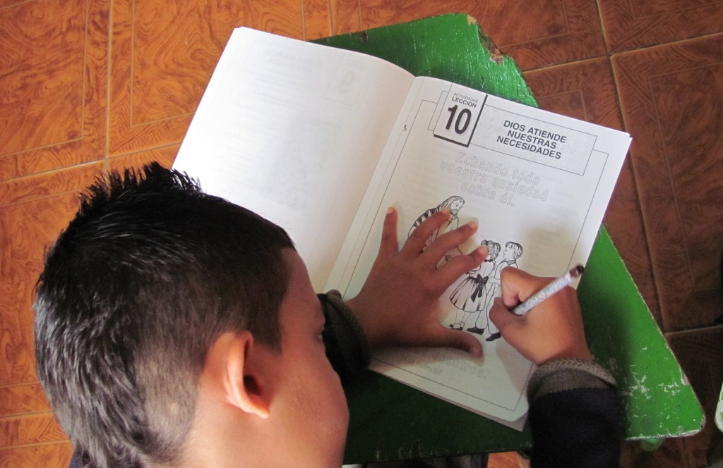
To WHOM do they go?

Slide 26
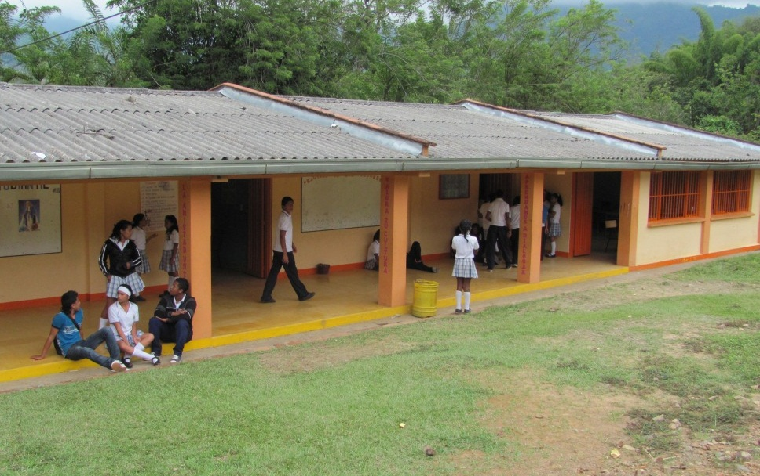
To WHOM do they go?

Slide 27
How we can pray for them:
PRAY…
That God would keep them close to Himself in their personal & family walk with the Lord.
That God would open doors for them to reach out into more schools.
That through these missionary teachers, God would change the hearts of boys and girls, and their parents and class-teachers.
That God would help them to work together in harmony, encouraging and supporting one another in their work.
We can also join with our Assembly by being involved in providing practical support for them.

